Slide 1

Methods and Summary

Slide 2
Goals
What data endpoints are most correlated across tests
Do these endpoints relate to “Anxiety”, “Pro Social Behavior”, or “Pair Bonding”
Does FM550 Affect these aforementioned traits

Slide 3
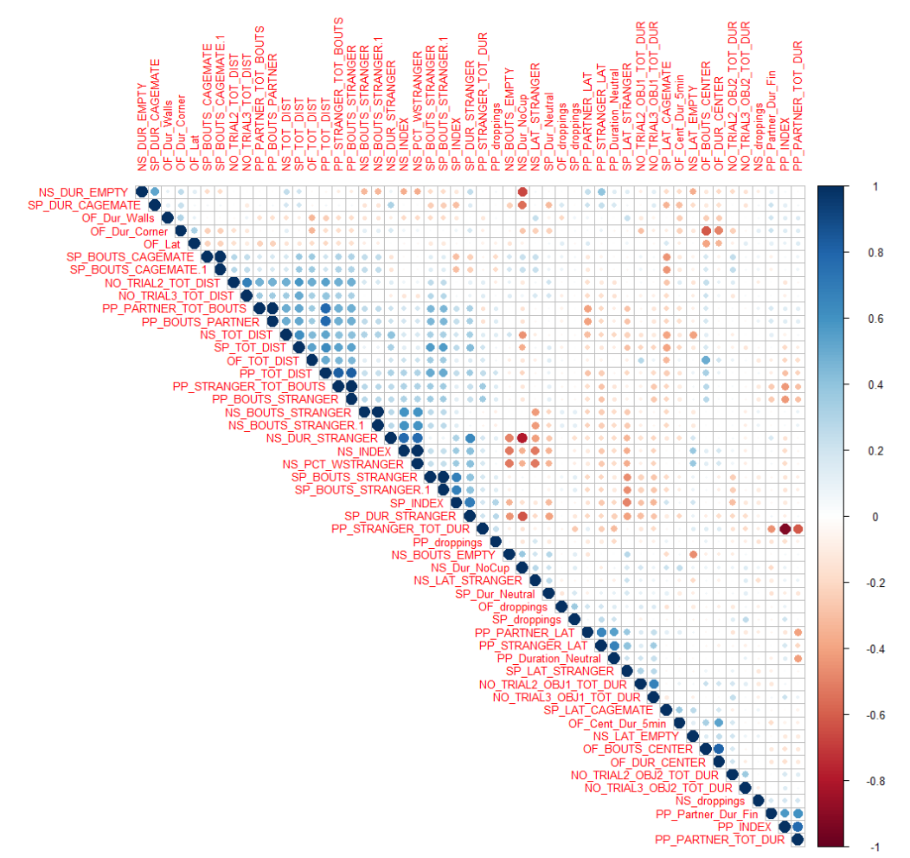
All Behavioral Endpoints
Key Points:
Distance Variables are highly correlated across tests
Stranger interactions are correlated across tests
Partner Preference in opposite sex encounters correlate differently than same sex interactions

Slide 4
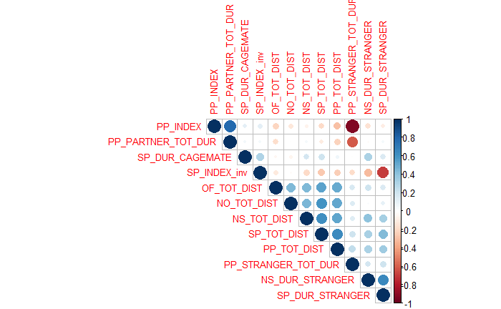
Primary Endpoints
Key Points:
Distances clustered
Stranger interactions clustered
Partner and cage mate correlations markedly different
Notes:
Blue indicates positive correlations. For example, NS_TOT_DIST and SP_TOT_DIST are strongly positively correlated, suggesting that a vole who travels a lot in the NS test also travels a lot in the SP test.
Red indicates negative correlations. For example, the PP_INDEX and PP_STRANGER_TOT_DUR are strongly negatively correlated, suggesting that a vole who scores high in the PP_INDEX (prefers spending time with their pair-bonded mate over a stranger) spends less time interacting with the stranger in the PP test.
Note: Correlation doesn’t imply causation. From these correlation plots, we can’t say that a high NS_TOT_DIST causes a high SP_TOT_DIST, only that the two tend to increase or decrease in the same direction.

Slide 5
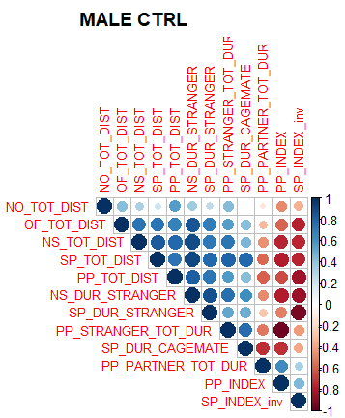
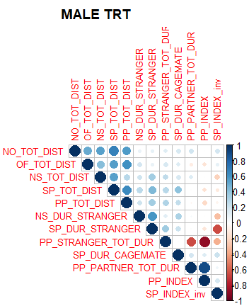
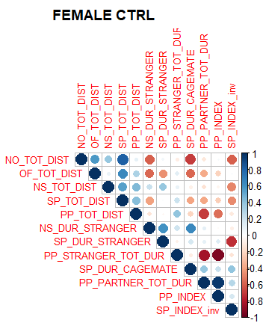
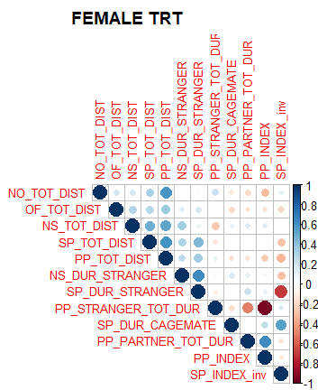
Primary Endpoints CTRL vs TREATED
Males show stronger correlations across the board. Correlations diminish with “Treatment”. Possibly due to small sample size.
 | M | F
CTRL | 11 | 10
TRT | 27 | 28
Females have weaker correlations but still share similarities in distances and stranger interactions. Males and females have different responses to opposite sex voles.

Slide 6
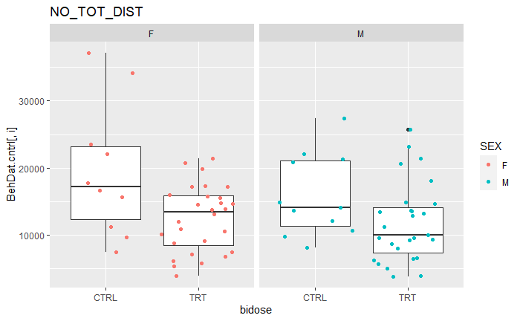
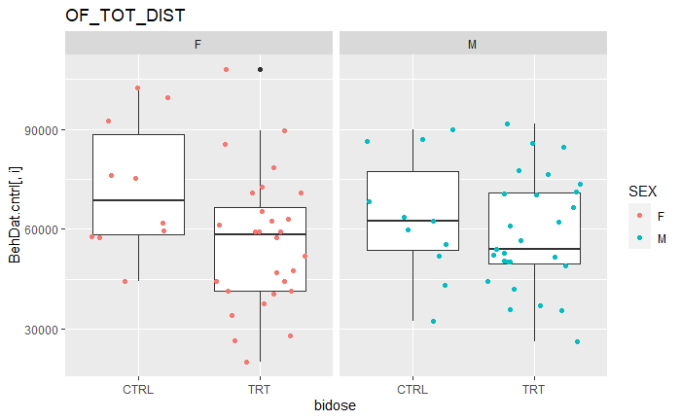
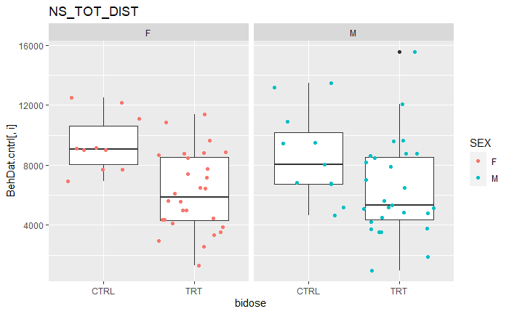
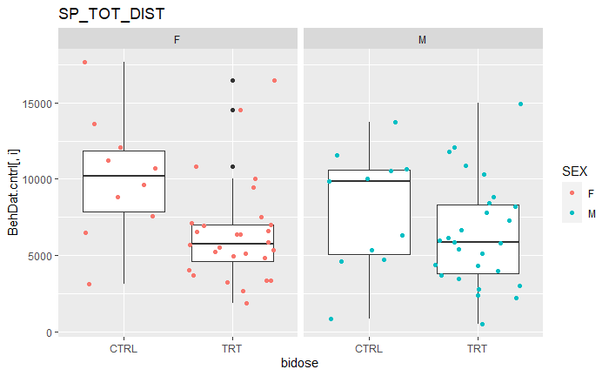
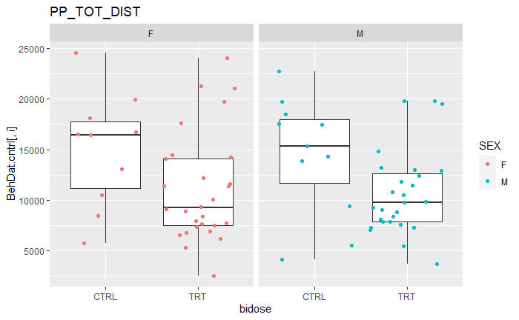
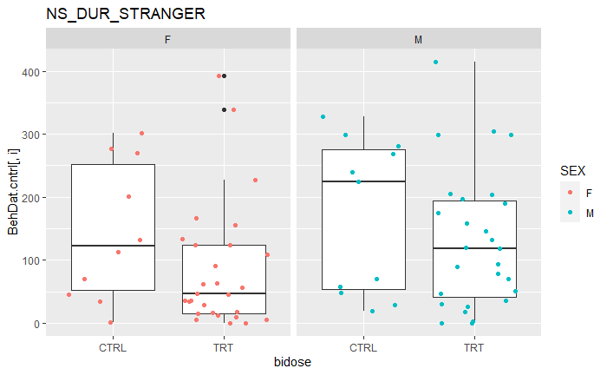
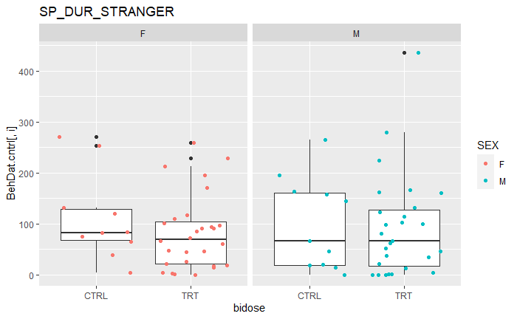
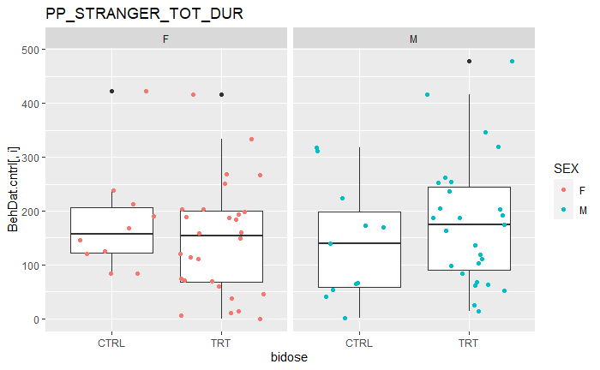
Primary Endpoints CTRL vs TREATED
Notes:
In each of the 8 paired box plots, the females are the left box and the males are the right box.
Note: In all of the 5 distance variables (NO_TOT_DIST, OF_TOT_DIST, NS_TOT_DIST, SP_TOT_DIST, PP_TOT_DIST), both females and males show a decrease in the distances travelled in the treatment (TRT) group.
Note: In the same-sex interaction time variables (NS_DUR_STRANGER, SP_DUR_STRANGER), there still appears to be a trend of decreased interaction with the stranger, although it is less clear.
Note: In the opposite-sex interaction time variable (PP_STRANGER_TOT_DUR), there is no clear trend. An argument could be made that treated males prefer the stranger more than control males, but it’s difficult to compare when the control sample sizes are quite small.

Slide 7
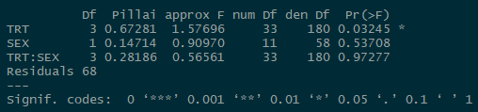
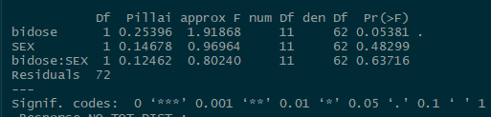
Primary Endpoints: MANOVA
Treating exposure at 4 levels
Key Summary:
Across all variables, there appears to be evidence of a FM550 effect
This effect does not appear to be sex specific
Treating exposure as a binary Y/N
Notes:
MANOVA = Multivariate analysis of variance
MANOVA is related to ANOVA, which stands for “Analysis of Variance”.
In the simpler ANOVA test, you are interested in the difference in means between two or more groups.
EX: You test if TRT had a significant effect on a single endpoint (like NS_TOT_DIST).
In the MANOVA test, you are interested in the differences in means of multiple variables between two or more groups.
EX: You test if TRT has a significant effect on multiple endpoints (like all the distance variables).
How to Read Output (shown here)
In reading these printed outputs (produced in R), the most important thing is to look at the Pr(>F) or P-value column. A common rule-of-thumb is to look P-values < 0.05 to determine significance. R helpfully marks those variables with P-values < 0.05 with a “*”, and those < 0.10 with a “.”
Although this P-value rule-of-thumb is useful for quickly glancing at the data, we examine more complex models to confirm that TRT has a significant effect on the responses we measured (like distance and interaction time).
Note: The “TRT:SEX” row is R notation for checking the significance of an interaction term.
I like to think of interaction terms as “it depends” effects.
EX: Let’s consider how the variables of food and condiment choice determine the satisfaction you get from your meal. For simplicity’s sake, let’s say you have ice cream and a hamburger as your food choices, and chocolate sauce and ketchup as your condiment choices.
You might ask “Does adding just ice cream to your plate increase satisfaction? Does adding just ketchup increase satisfaction?” to examine individual variables, much like you might ask “Does TRT affect the response? Does SEX affect the responses?”
You might also ask “Does adding ice cream AND ketchup increase satisfaction?” to examine the interaction effect between the food variable and the condiment variable. Maybe ice cream or ketchup on their own increase satisfaction, but their combination certainly doesn’t! The same is true of examining TRT:SEX. Does the combination of the two produce something different than the simple sum of its parts? In this case, the TRT:SEX interaction terms are insignificant with high P-values (suggesting they don’t add anything to the MANOVA).

Slide 8
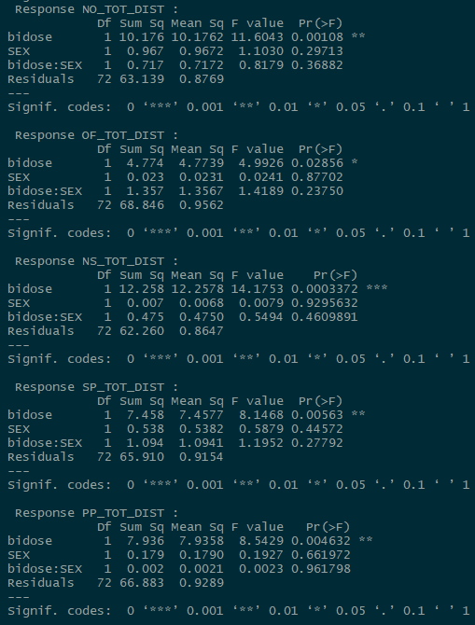
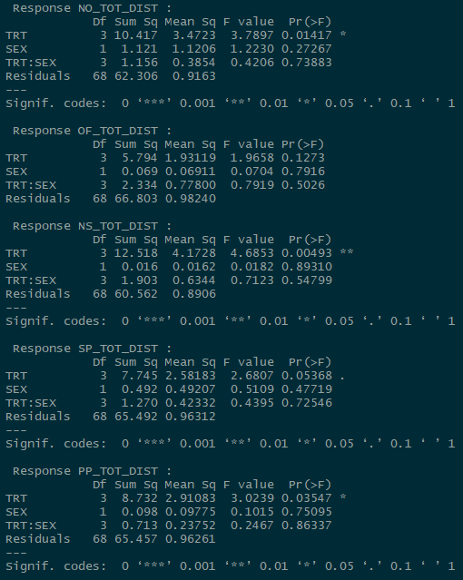
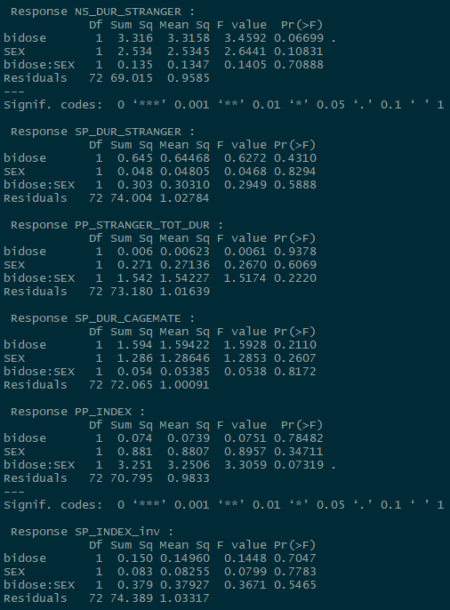
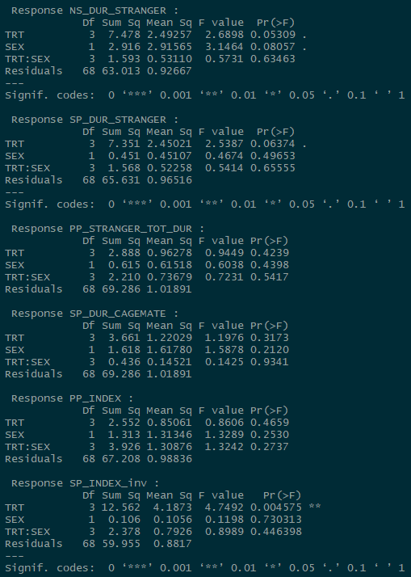
Primary Endpoints: ANOVA
Key Summary:
Distance variables show the most difference across treatment groups
This effect does not appear to be sex specific
Social variables show less of an effect
Notes:
The lefthand column contains ANOVA test results for a binary treatment variable (CTRL vs. TREATED) and a sex variable and their interaction term.
We see the binary treatment variable (CTRL vs. TREATED) is significant in all the distances NO_TOT_DIST, OF_TOT_DIST, NS_TOT_DIST, SP_TOT_DIST, PP_TOT_DIST.
The sex variable is not significant.
We also see the binary treatment variable (CTRL vs. TREATED) is less clearly significant in the various time variables (NS_DUR_STRANGER, SP_DUR_STRANGER, PP_STRANGER_TOT_DUR, SP_DUR_CAGEMATE) and the indices generated off those time variables (PP_INDEX, SP_INDEX). There are still some ‘significant’ variables if you consider P-value < 0.10, but the P-value rule is just a general rule-of-thumb and we should take these ‘significant’ findings with a grain of salt, especially because there is no consistent pattern.
Note: SP_INDEX_inv is an inverted version of the SP_INDEX where -1 indicates a stranger preference and 1 indicates a cagemate preference.
The righthand column contains ANOVA test results for a 4-category treatment variable (CTRL, LOW, MID, HIGH) and a sex variable and their interaction term.
Again, we see the treatment variable is significant in most of the distances, although the relationship is less clear-cut. This can be due to the fact that the binary treatment variable works with a larger sample size (all the LOW/MID/HIGH voles grouped together) vs. the 4-category treatment variable.
The sex variable is not significant.
And again, we also see the treatment variable is less clearly significant in the various time and social index variables.

Slide 9
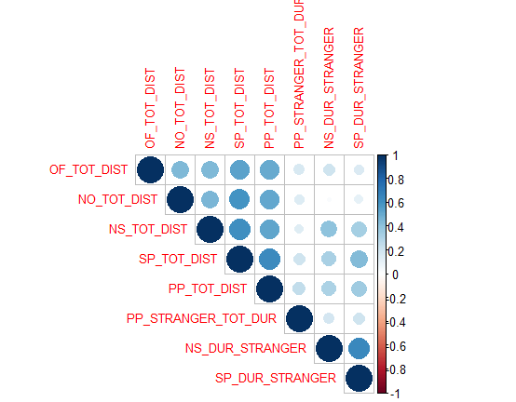
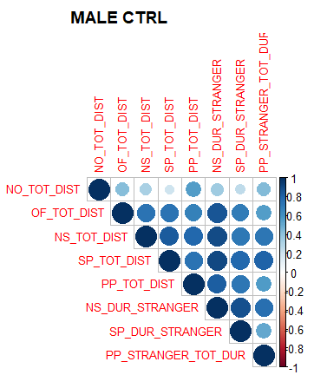
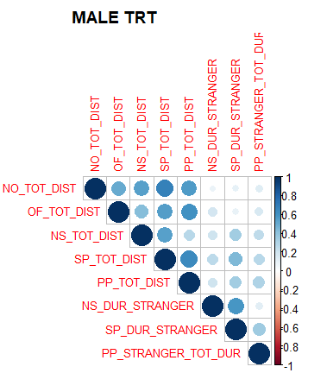
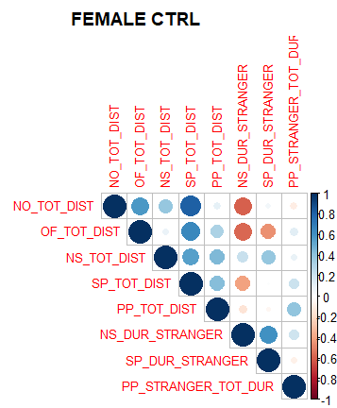
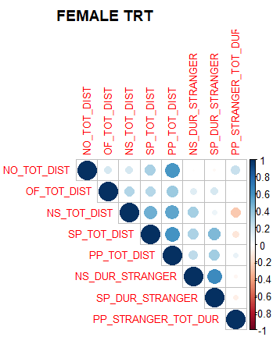
Simplifying the Model
Can we focus on the commonalities in the underlying structure?
“Anxiety”
Key Summary:
Can we extract what's “common” between these variables to create a single new variable, or common factor
Are these “Common Factors” affected by FM550?
“Sociability”
Notes:
One popular way of reducing many variables or ‘features’ in a model is factor analysis.
The idea is that there are unseen factors or ‘latent variables’ that affect many measured variables. EX: A mental-health assessment asks many questions to assess depression, but depression is the single unseen variable the surveyors are interested in).
We won’t describe the mathematical details too much, but it’s important to recognize 2 main types of factor analysis. Exploratory factor analysis allows the data to drive the selection of the best model. In confirmatory factor analysis, we instead propose a model for the factors (how many factors? What variables go into each factor?) and check how well it explains the data. You can think of confirmatory factor analysis as generating a hypothesis about the factors and then testing it.

Slide 10
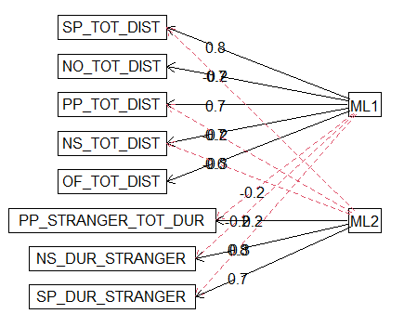

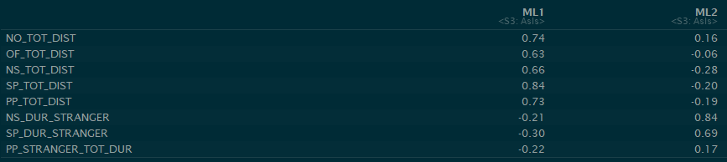
Exploratory Factor Model
Factor loadings, “How well the factor is explaining the variable”. Similar to correlation.
“Anxiety”
Dotted red lines indicate a negative relationship
“Sociability”
Key Summary:
This model represents the best case for extracting the commonalities
Positive relationship between distance traveled (inverted) and “Anxiety” as well as Time spent with strangers and “Sociability”
We invert distance traveled so that less distance traveled means more anxiety. Invert by subtracting every value from the max of each column. The highest value of distance traveled will become 0.
Cross factor negative relationships as well. Does “Anxiety” negatively correlate with “Sociability”?
How well the model fits:
Good Model Guidelines:
Tucker Lewis Index > .95 Pval > 0.05 (Small Pval = poor fit*)
RMSEA < .05
Factor loadings (correlations)
Notes:
Exploratory factor analysis suggests relationships amongst the variables to help guide further analysis. It casts a wide net to show how each variable is influenced by the proposed factors. Notice how variables can be connected to both factors (cross lines)
Confirmatory Factor Analysis (shown later) defines the exact relationships amongst variables. This is the end goal!
We introduce the exploratory factor model to provide some background on how many factors make sense and what variables should go into which factors.
How to Read the “Factor Loadings”
In general, you can read the factor loadings like you read a correlation coefficient. A higher value indicates a stronger relationship (so NO_TOT_DIST is much more important to the factor we call “ML1” or “Anxiety” than to “ML2” or “Sociability”). A positive value indicates a positive relationship.

Slide 11
Confirmatory Factor Model
Can we create a specific model where distance variables (inverted) are influenced by anxiety, Stranger duration variables are influenced by sociability, and anxiety is correlated with sociability?
FM550
?
Proposed design
Anxiety
Sociability
D1
D1
D1
D1
D1
S1
S2
S3

Slide 12
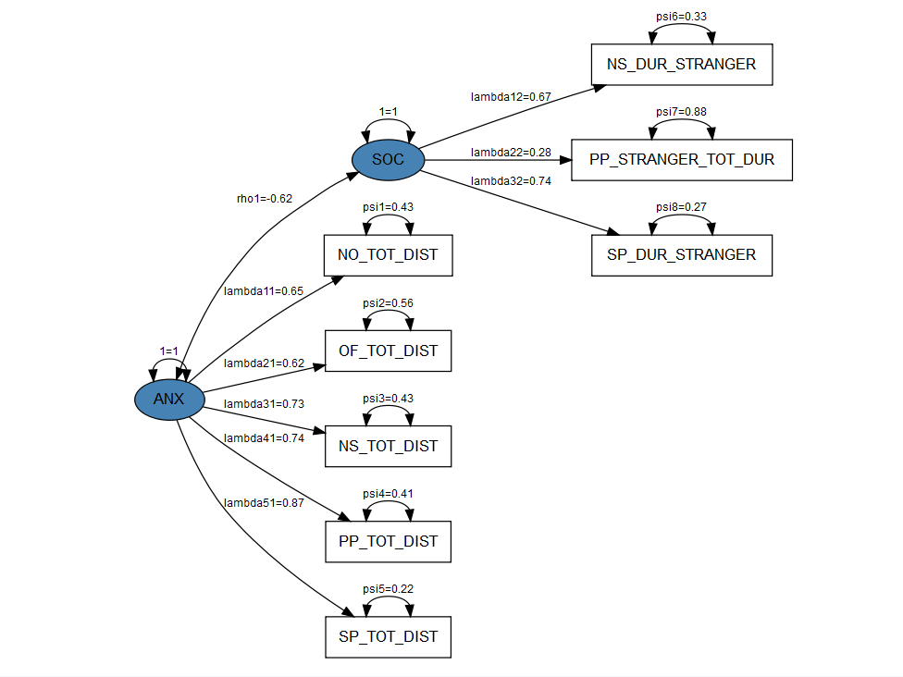
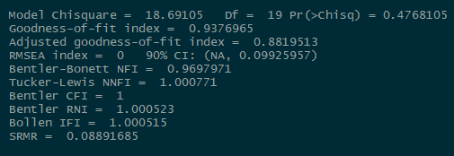
Confirmatory Factor Model
Key Summary:
Proposed model “fits” moderately well
There is a negative correlation between “Anxiety” and “Sociability”
PP stranger interaction is the weakest in terms of being explained by “Sociability” (opposite sex interactions should be separated)
We can now extract these “factor scores” to create two new variables for the voles
Good Model Guidelines:
Tucker Lewis Index > .95 Pval > 0.05 (Small Pval = poor fit*)
RMSEA < .05
Recall the previous model had:
Tucker Lewis Index = 1.06
Pval = 0.87
RMSEA = 0.00
Notes:
This model did not fit the data quite as well as the exploratory factor analysis, although it was still good! We see the Tucker Lewis index is not as large and the P-value is not as large as in the exploratory factor analysis model.
We would still recommend using this 2nd model for inference because it has more strictly specified factors (we don’t allow variables to be included in both the anxiety and sociability factors) and we can consider this model like a hypothesis test.
Looking at the factor loadings, we see PP_STRANGER_TOT_DUR has the smallest value of the three variables that the “SOC” factor is hypothesized to affect. This is the weakest link and provides further evidence that the opposite-sex interactions might need to be separated from other sociability measures. You can look at how the voles score in these 2 newly created variables of ANX and SOC (see next slide).
What Is A Factor Score? Imagine if you could measure the anxiety and sociability of a vole directly. Well, with this factor model, now you can! We feed the model the measured distance and time variables, and it computes factor scores, which are equivalent to it’s best guess at a vole’s direct measures of anxiety and sociability.

Slide 13
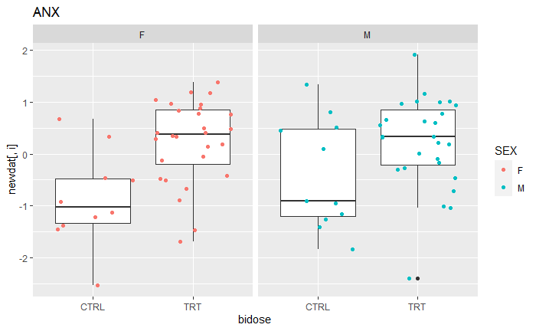
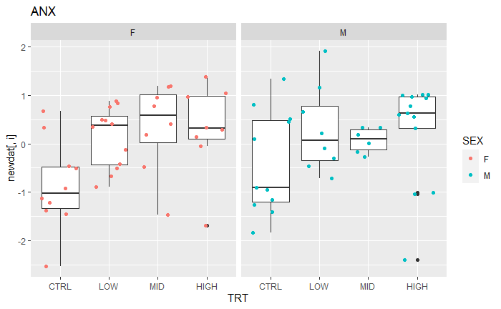
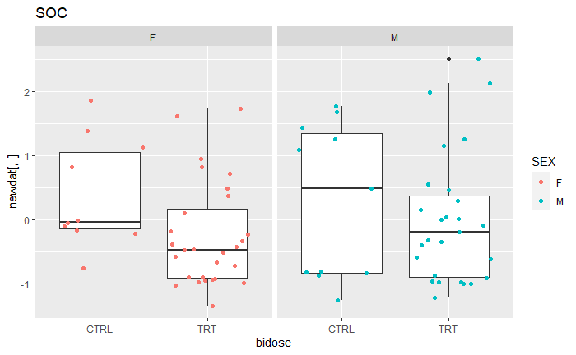
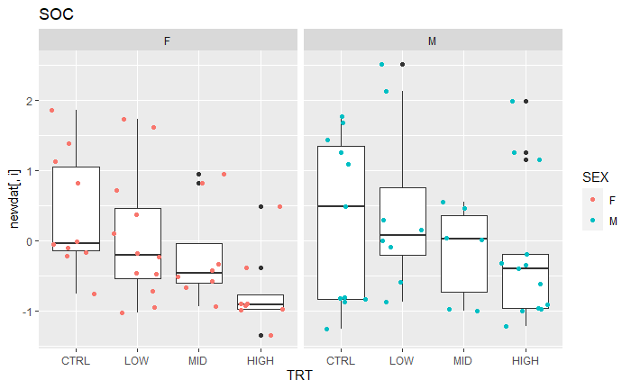
Factor Scores CTRL vs TREATED
Notes:
Overall, exposure results in increased ANX across both sexes, and decreased SOC across both sexes.
While the right-most boxplots suggest a dose-dependent response, we would caution against making this assertion. The middle 50% of those boxplots overlap a lot between the different treatment groups, and there are also fewer data points to generate each box plot (so we’re less sure if these box plots are accurate).
Ideally, we could also increase the number of CTRL females and males so that there is even representation between the CTRL vs. the TRT-ed individuals.

Slide 14
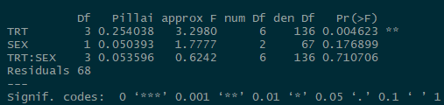
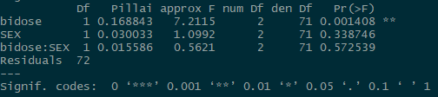
Factor Scores: MANOVA
Treating exposure at 4 levels
Key Summary:
There seems to be evidence of an effect of FM550 on both Anxiety and Sociability
Based on our factor model, sex is not a major driving role
Treating exposure as a binary Y/N
Notes:
Just like we used a MANOVA to analyze if treatment and sex had effects on all the distance and time variables, we can also use MANOVA to analyze if treatment and sex have effects on the new ANX and SOC factor ‘variables’ we’ve generated.
We see the same results as earlier. It appears treatment matters, sex does not.

Slide 15
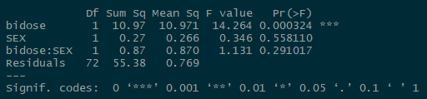
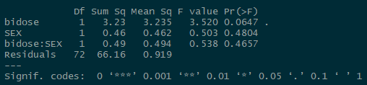
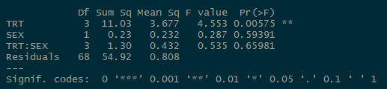
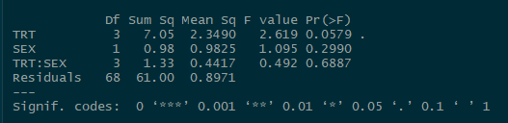
Factor Scores: ANOVA
ANOVA: Anxiety on Treatment and Sex
Treatment as binary Y/N
ANOVA: Sociability on Treatment and Sex
Key Summary:
Anxiety shows a significant relationship with both Treatment and “bidose”
Sociability shows a smaller effect with both as well
Is the 4 level model better than the 2 level binary model?
ANOVA: Anxiety on Treatment and Sex
Treatment as 4 levels
ANOVA: Sociability on Treatment and Sex
Notes:
Note: “bidose” is what we’re calling our binary version of the TRT vs. LOW/MID/HIGH variable.

Slide 16
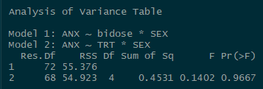
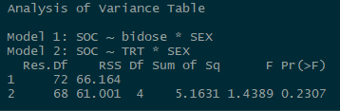
Factor Analysis: Dose Specific Effects
Testing: Is there a dose specific effect for anxiety?
Key Summary:
Both tests indicate that there is not a lot of dose specific effects on anxiety and sociability
There is more evidence of a dose specific effect on sociability than on anxiety
Testing: Is there a dose specific effect for sociability?
Notes:
These tests are also ANOVA tests, but they are a bit different from the ones on the previous slides.
In this ANOVA tests where we compare 2 models, there is usually one simpler model (Model 1 with a binary CTRL vs. LOW/MID/HIGH variable) and one more complex model (Model 2) with the 4-category (CTRL, LOW, MID, HIGH) variable.
Our null hypothesis states that the simpler Model 1 does a sufficient job explaining the data.
Our alternative hypothesis states that Model 1 is not sufficient in explaining the data, compared to the more complex Model 2.
In both of the table outputs displayed here, the P-values are quite large. Suggesting that we *fail* to reject the null hypothesis. The simpler Model 1 with its binary CTRL vs. LOW/MID/HIGH variable is good enough!

Slide 17
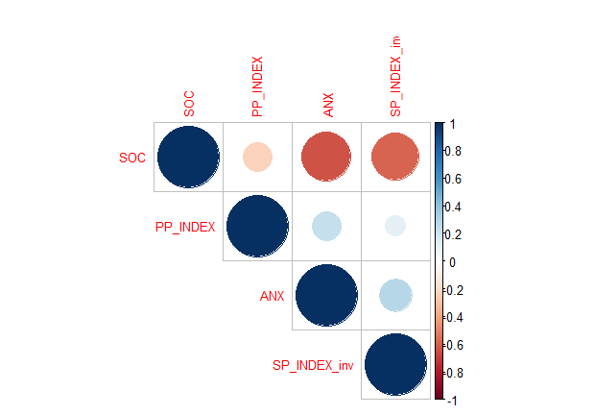
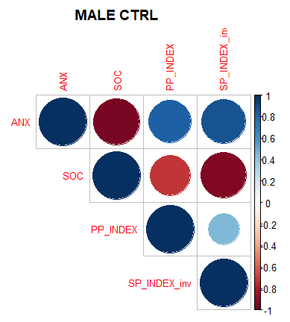
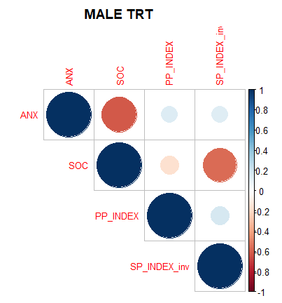
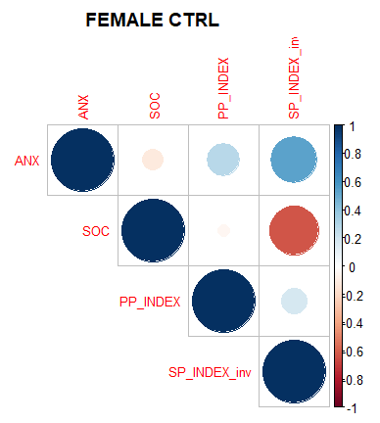
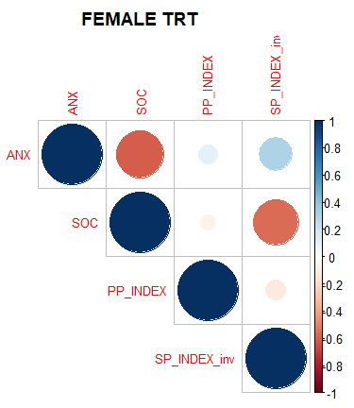
Factor Scores: Pair Bonding
All Voles
The more social the vole, the less they need to sit by their partner or cagemate
The more anxiety, the more they sit by their partner (or potentially no vole at all)
Key Summary:
Similar relationships hold through with the factor scores
Future investigation into just CTRL voles to get a baseline behavior
More voles to build separate models for Males and Females
Males, with more n, could support a 3rd factor for “Pair Bonding”
Notes:
Suggested directions of future research?
Clearly, there is a difference between general sociability in voles and opposite-sex, pair-bonding related sociability. The SOC factor we built is negatively correlated with ANX and negatively correlated with SP_INDEX_inv, but not strongly correlated in either positive or negative directions with PP_INDEX. We should probably consider PP_INDEX for a third factor, which we may call “Pair Bonding”

Slide 18
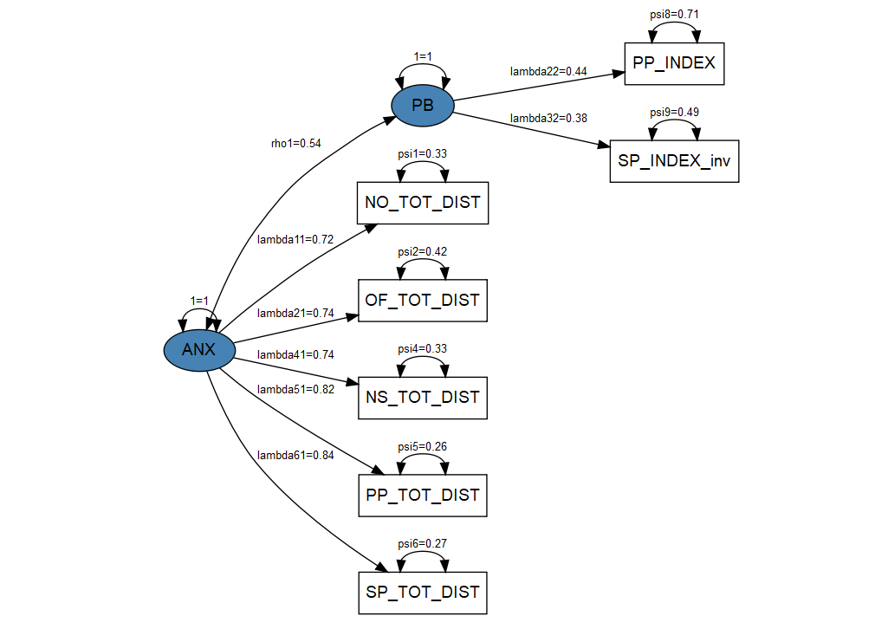

Factor Scores: Pair Bonding Cont.
**N too small to fit proper model**
Key Summary:
Potential for a “Pair Bonding” factor.
Would need more voles (preferably male, and in the CTRL)
Good Model Guidelines:
Tucker Lewis Index > .95 Pval > 0.05 (Small Pval = poor fit*)
RMSEA < .05
Notes:
We can build a confirmatory factor model with an ANX factor and PB (Pair Bonding) factor and it fits okay. This model would probably benefit a lot from having more CTRL male voles, those who show the strongest pair-bonding behavior.

Slide 19
Goals Revisited
What data endpoints are most correlated across tests
Distances are highly correlated
General social behavior with new voles correlated
The correlations change when its same sex vs opposite sex
Do these endpoints relate to “Anxiety”, “Pro Social Behavior”, or “Pair Bonding”
The correlated variables have a “commonness” about them that allows us to extract it into two common factors
Subjective knowledge tells us this “commonality” is closely related to the vole’s anxiety and sociability
Allows for macro level analysis: Does FM550 affect anxiety vs Does FM550 affect the distance traveled in a single test
There is some evidence of a 3rd common factor of “pair bonding”, mainly with males.
To add more factors, a larger sample size is needed, preferably males
Does FM550 Affect these aforementioned traits
With the extracted scores representing anxiety and sociability, we can conclude that there is evidence that FM550 affects the voles level of anxiety and sociability

